Slide 1
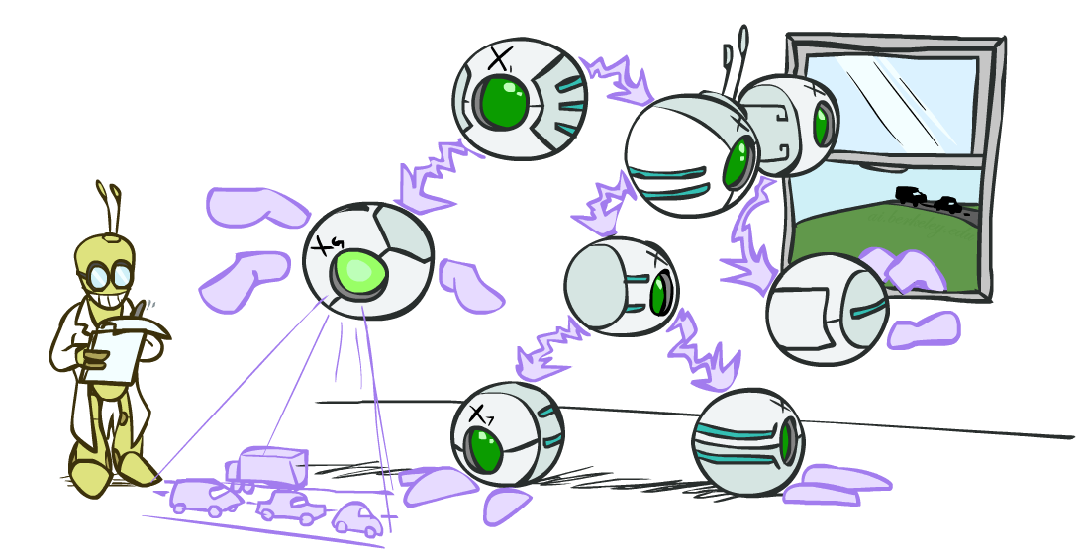
CS 188: Artificial Intelligence
Bayes’ Nets: Inference and Sampling
Instructors: Dan Klein and Pieter Abbeel --- University of California, Berkeley
[These slides were created by Dan Klein and Pieter Abbeel for CS188 Intro to AI at UC Berkeley. All CS188 materials are available at http://ai.berkeley.edu.]
Notes:
Please retain proper attribution, including the reference to ai.berkeley.edu. Thanks!

Slide 2
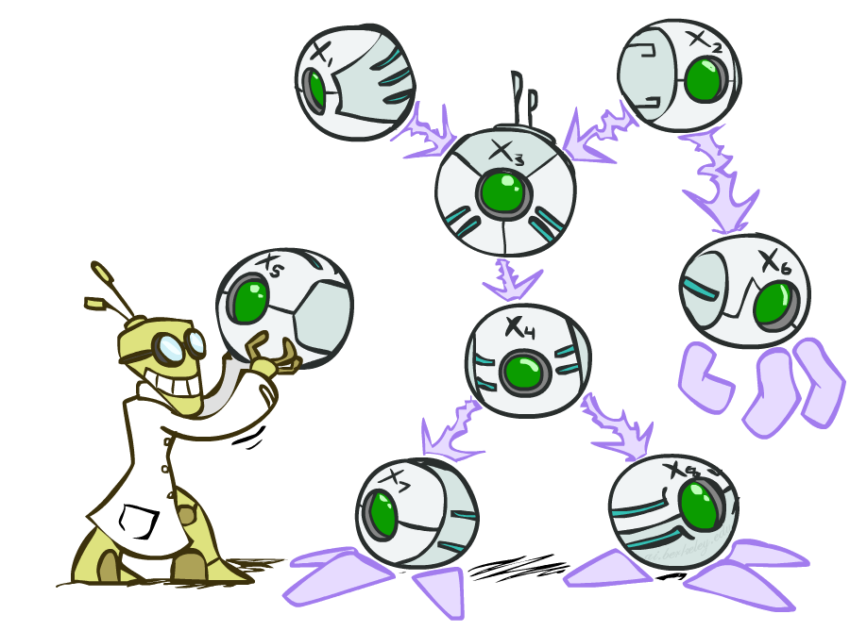
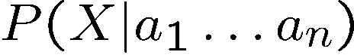
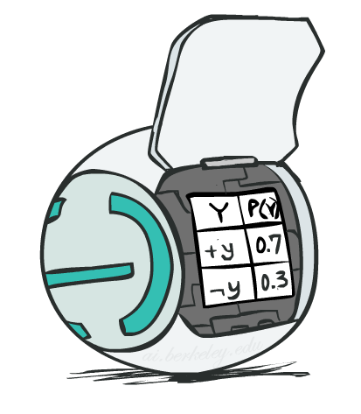
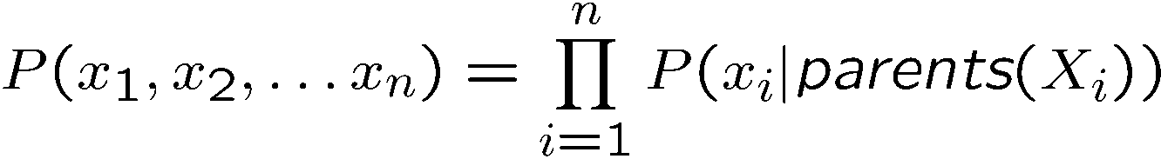
Bayes’ Net Representation
A directed, acyclic graph, one node per random variable
A conditional probability table (CPT) for each node
A collection of distributions over X, one for each combination of parents’ values
Bayes’ nets implicitly encode joint distributions
As a product of local conditional distributions
To see what probability a BN gives to a full assignment, multiply all the relevant conditionals together:

Slide 3
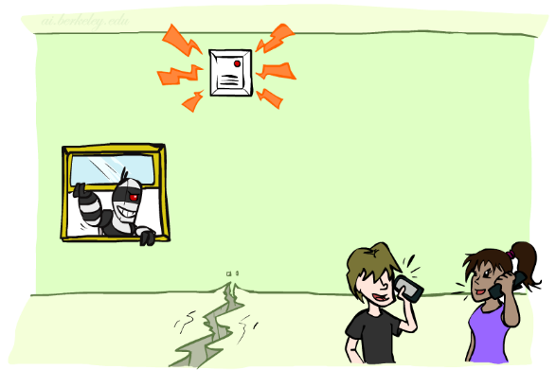
Example: Alarm Network
B | P(B)
+b | 0.001
-b | 0.999
E | P(E)
+e | 0.002
-e | 0.998
Burglary
Earthqk
Alarm
B | E | A | P(A|B,E)
+b | +e | +a | 0.95
+b | +e | -a | 0.05
+b | -e | +a | 0.94
+b | -e | -a | 0.06
-b | +e | +a | 0.29
-b | +e | -a | 0.71
-b | -e | +a | 0.001
-b | -e | -a | 0.999
John calls
Mary calls
A | J | P(J|A)
+a | +j | 0.9
+a | -j | 0.1
-a | +j | 0.05
-a | -j | 0.95
A | M | P(M|A)
+a | +m | 0.7
+a | -m | 0.3
-a | +m | 0.01
-a | -m | 0.99
[Demo: BN Applet]
Notes:
Demo:
Draw network
Specify the CPTs
Then query, e.g., Mary Calls --- not something we specified, inference computed this for us
P(B) = ?
P(B | +e) = ?
Independence
P(B) = ?
P(B | +m) = ?
Show explaining away

Slide 4
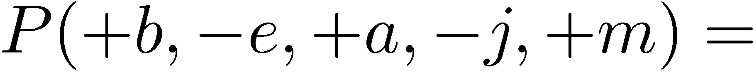
Example: Alarm Network
B | P(B)
+b | 0.001
-b | 0.999
B
E
E | P(E)
+e | 0.002
-e | 0.998
A
A | J | P(J|A)
+a | +j | 0.9
+a | -j | 0.1
-a | +j | 0.05
-a | -j | 0.95
A | M | P(M|A)
+a | +m | 0.7
+a | -m | 0.3
-a | +m | 0.01
-a | -m | 0.99
B | E | A | P(A|B,E)
+b | +e | +a | 0.95
+b | +e | -a | 0.05
+b | -e | +a | 0.94
+b | -e | -a | 0.06
-b | +e | +a | 0.29
-b | +e | -a | 0.71
-b | -e | +a | 0.001
-b | -e | -a | 0.999
J
M
Notes:
demo

Slide 5

Example: Alarm Network
B | P(B)
+b | 0.001
-b | 0.999
B
E
E | P(E)
+e | 0.002
-e | 0.998
A
A | J | P(J|A)
+a | +j | 0.9
+a | -j | 0.1
-a | +j | 0.05
-a | -j | 0.95
A | M | P(M|A)
+a | +m | 0.7
+a | -m | 0.3
-a | +m | 0.01
-a | -m | 0.99
B | E | A | P(A|B,E)
+b | +e | +a | 0.95
+b | +e | -a | 0.05
+b | -e | +a | 0.94
+b | -e | -a | 0.06
-b | +e | +a | 0.29
-b | +e | -a | 0.71
-b | -e | +a | 0.001
-b | -e | -a | 0.999
J
M
Notes:
demo

Slide 6

Bayes’ Nets
Representation
Conditional Independences
Probabilistic Inference
Enumeration (exact, exponential complexity)
Variable elimination (exact, worst-case exponential complexity, often better)
Inference is NP-complete
Sampling (approximate)
Learning Bayes’ Nets from Data

Slide 7

Inference
Inference: calculating some useful quantity from a joint probability distribution
Examples:
Posterior probability
Most likely explanation:

Slide 8
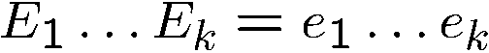
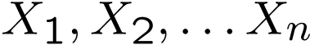
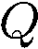
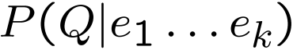
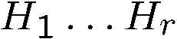
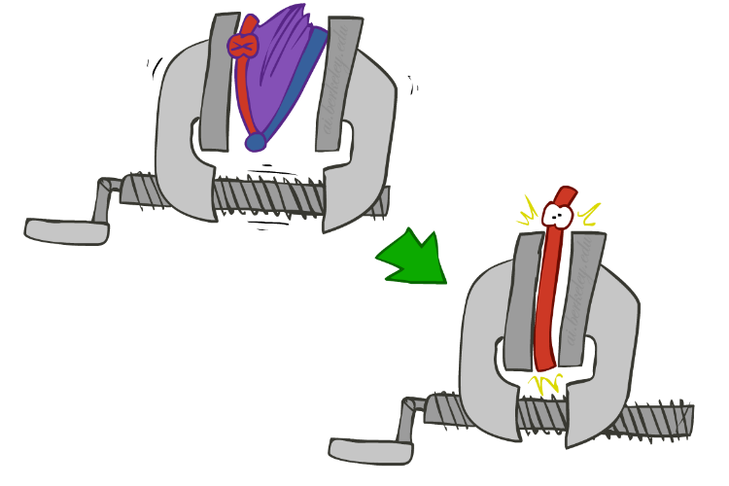
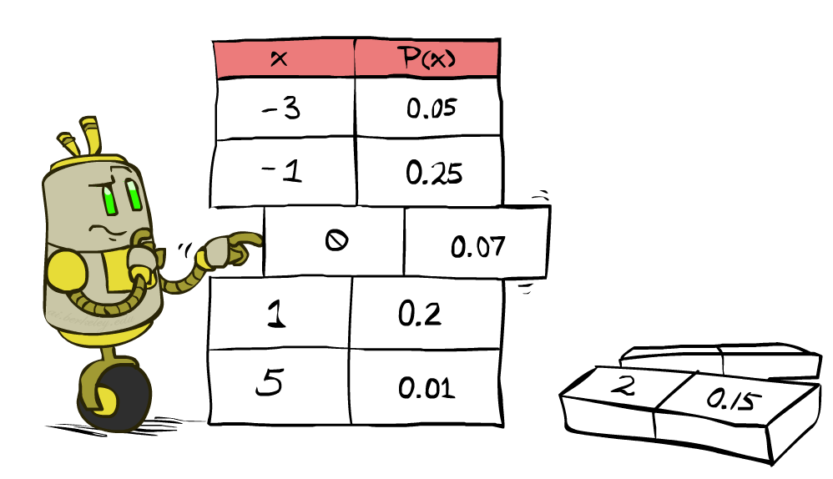
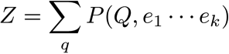
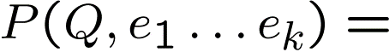
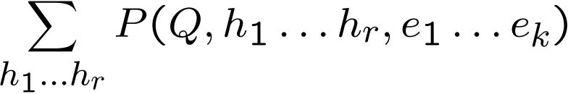
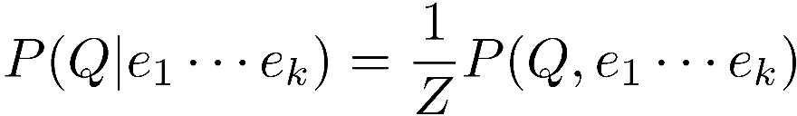
Inference by Enumeration
* Works fine with multiple query variables, too
General case:
Evidence variables:
Query* variable:
Hidden variables:
We want:
All variables
Step 1: Select the entries consistent with the evidence
Step 2: Sum out H to get joint of Query and evidence
Step 3: Normalize

Slide 9
Inference by Enumeration in Bayes’ Net
Given unlimited time, inference in BNs is easy
Reminder of inference by enumeration by example:
B
E
A
J
M

Slide 10
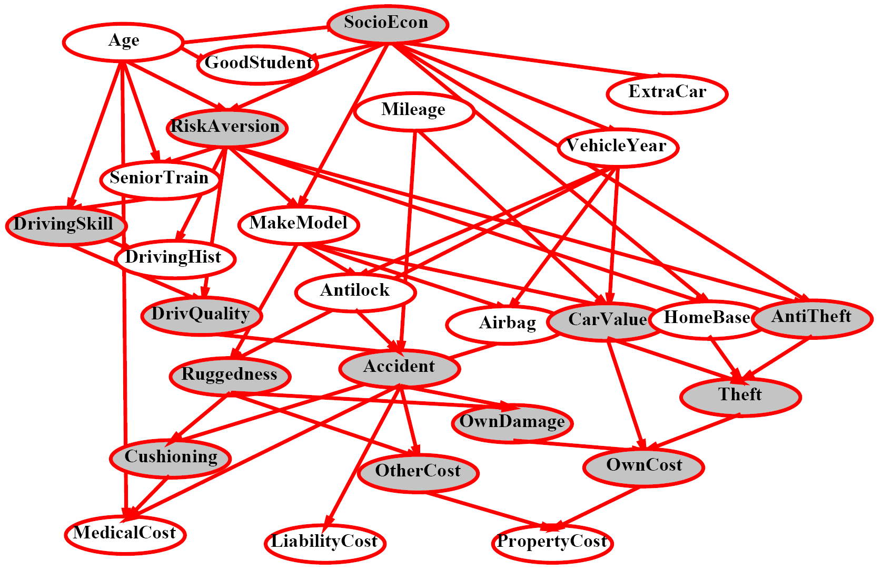
Inference by Enumeration?

Slide 11
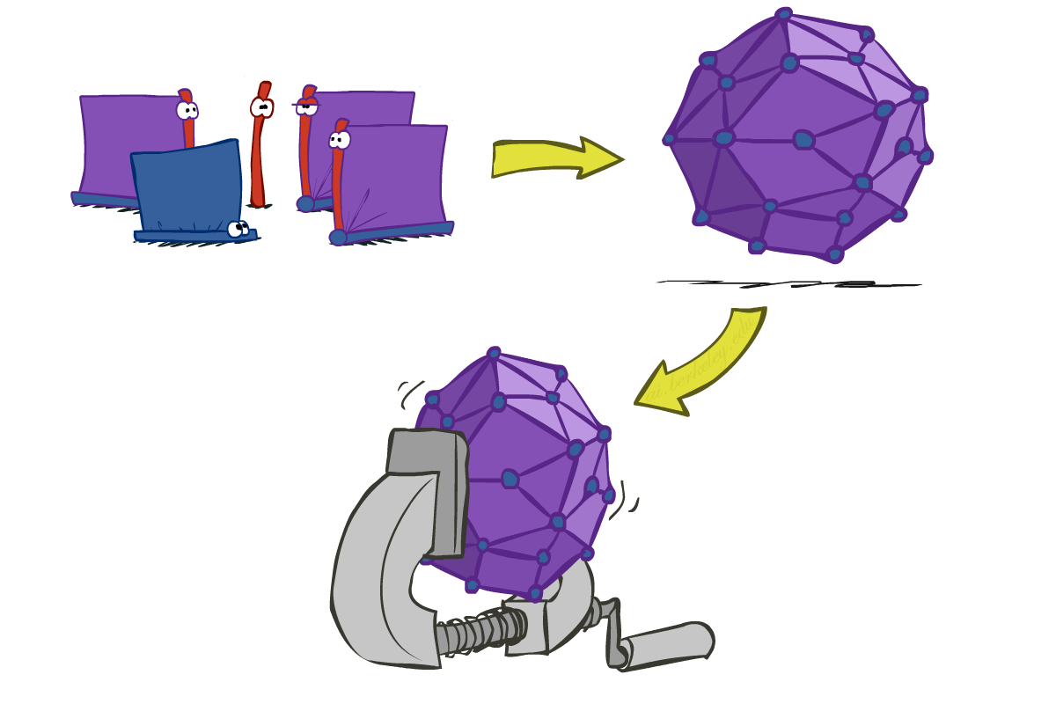
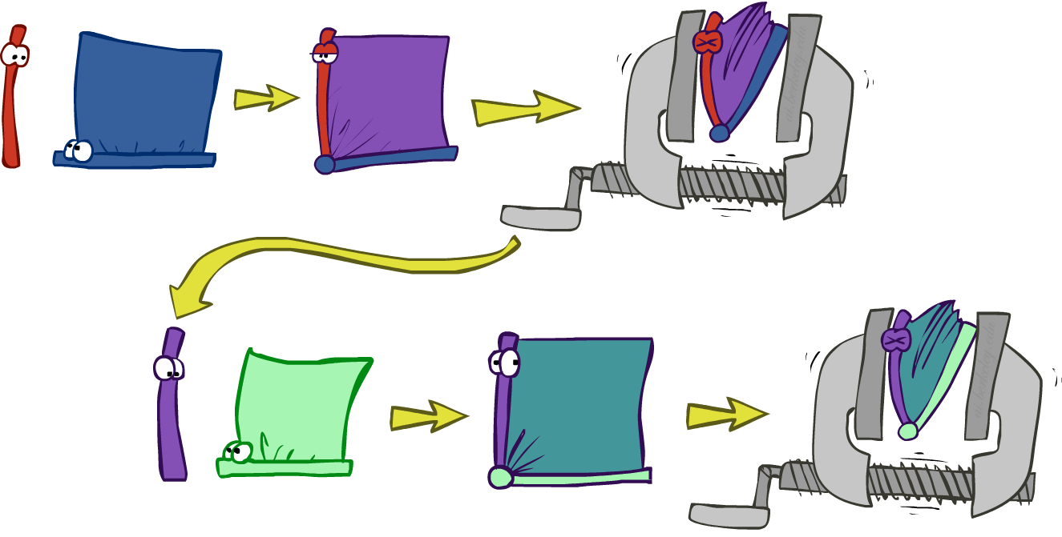
Inference by Enumeration vs. Variable Elimination
Why is inference by enumeration so slow?
You join up the whole joint distribution before you sum out the hidden variables
Idea: interleave joining and marginalizing!
Called “Variable Elimination”
Still NP-hard, but usually much faster than inference by enumeration
First we’ll need some new notation: factors

Slide 12
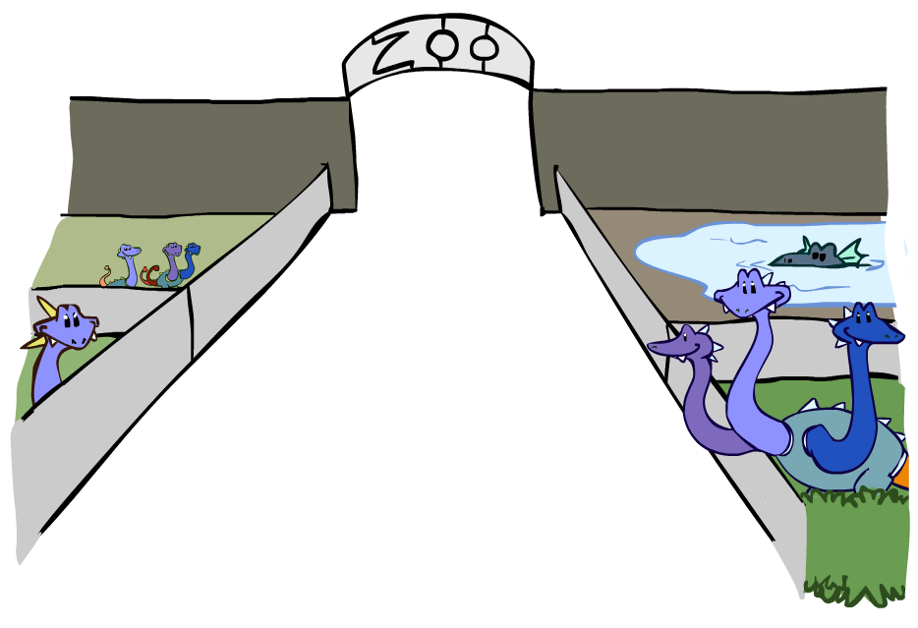
Factor Zoo

Slide 13
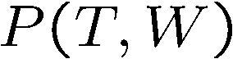

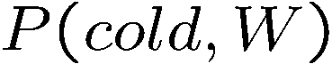
Factor Zoo I
Joint distribution: P(X,Y)
Entries P(x,y) for all x, y
Sums to 1
Selected joint: P(x,Y)
A slice of the joint distribution
Entries P(x,y) for fixed x, all y
Sums to P(x)
Number of capitals = dimensionality of the table
T | W | P
hot | sun | 0.4
hot | rain | 0.1
cold | sun | 0.2
cold | rain | 0.3
T | W | P
cold | sun | 0.2
cold | rain | 0.3

Slide 14
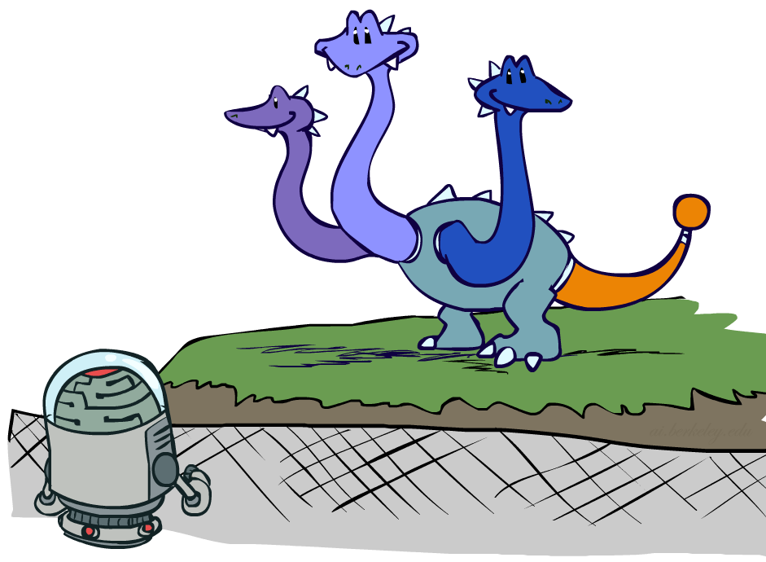
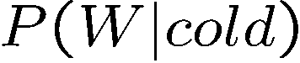
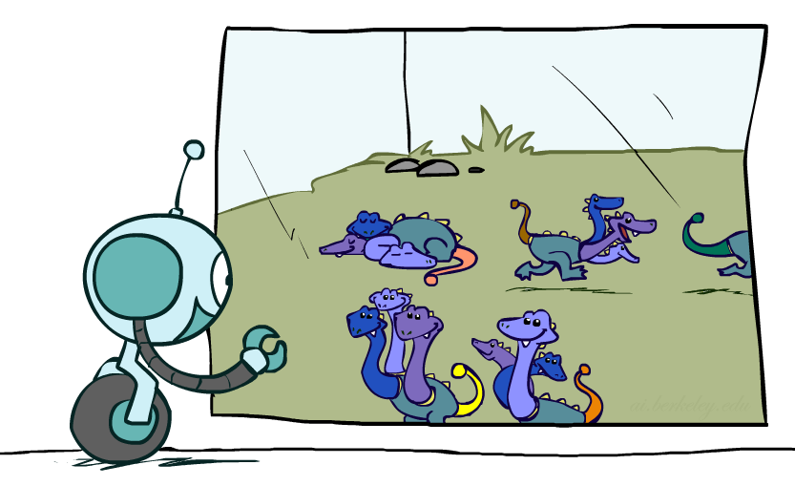
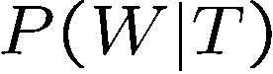
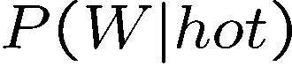

Factor Zoo II
Single conditional: P(Y | x)
Entries P(y | x) for fixed x, all y
Sums to 1
Family of conditionals:
P(X |Y)
Multiple conditionals
Entries P(x | y) for all x, y
Sums to |Y|
T | W | P
cold | sun | 0.4
cold | rain | 0.6
T | W | P
hot | sun | 0.8
hot | rain | 0.2
cold | sun | 0.4
cold | rain | 0.6

Slide 15
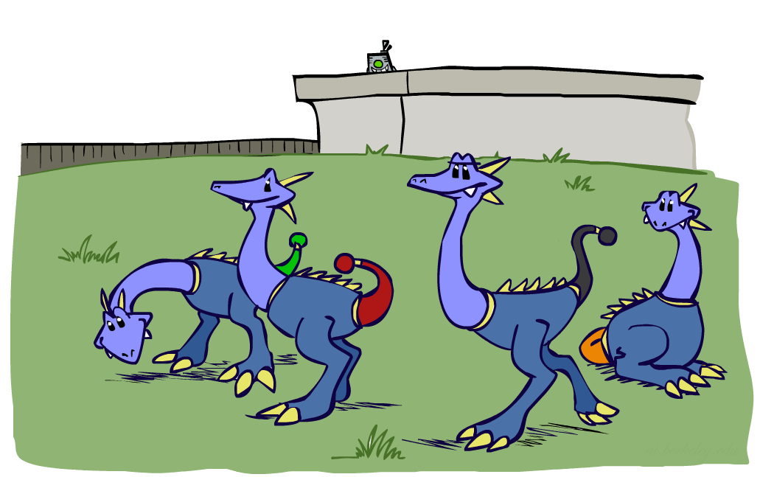
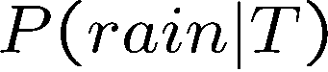
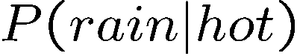
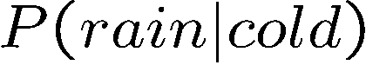
Factor Zoo III
Specified family: P( y | X )
Entries P(y | x) for fixed y,
but for all x
Sums to … who knows!
T | W | P
hot | rain | 0.2
cold | rain | 0.6

Slide 16




Factor Zoo Summary
In general, when we write P(Y₁ … Y_{N} | X₁ … X_{M})
It is a “factor,” a multi-dimensional array
Its values are P(y₁ … y_{N} | x₁ … x_{M})
Any assigned (=lower-case) X or Y is a dimension missing (selected) from the array

Slide 17
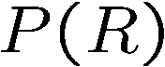
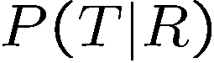
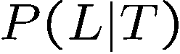
Example: Traffic Domain
Random Variables
R: Raining
T: Traffic
L: Late for class!
+r | 0.1
-r | 0.9
R
T
+r | +t | 0.8
+r | -t | 0.2
-r | +t | 0.1
-r | -t | 0.9
L
+t | +l | 0.3
+t | -l | 0.7
-t | +l | 0.1
-t | -l | 0.9

Slide 18

Variable Elimination (VE)

Slide 19

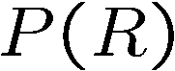
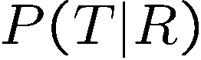
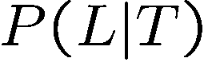
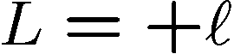
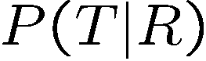
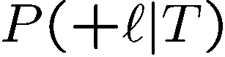
Inference by Enumeration: Procedural Outline
Track objects called factors
Initial factors are local CPTs (one per node)
Any known values are selected
E.g. if we know , the initial factors are
Procedure: Join all factors, then eliminate all hidden variables
+r | 0.1
-r | 0.9
+r | +t | 0.8
+r | -t | 0.2
-r | +t | 0.1
-r | -t | 0.9
+t | +l | 0.3
+t | -l | 0.7
-t | +l | 0.1
-t | -l | 0.9
+r | 0.1
-r | 0.9
+r | +t | 0.8
+r | -t | 0.2
-r | +t | 0.1
-r | -t | 0.9
+t | +l | 0.3
-t | +l | 0.1

Slide 20

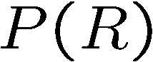

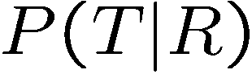
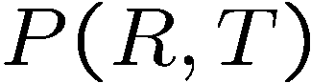
Operation 1: Join Factors
First basic operation: joining factors
Combining factors:
Just like a database join
Get all factors over the joining variable
Build a new factor over the union of the variables involved
Example: Join on R
Computation for each entry: pointwise products
R
+r | 0.1
-r | 0.9
+r | +t | 0.8
+r | -t | 0.2
-r | +t | 0.1
-r | -t | 0.9
+r | +t | 0.08
+r | -t | 0.02
-r | +t | 0.09
-r | -t | 0.81
R,T
T

Slide 21
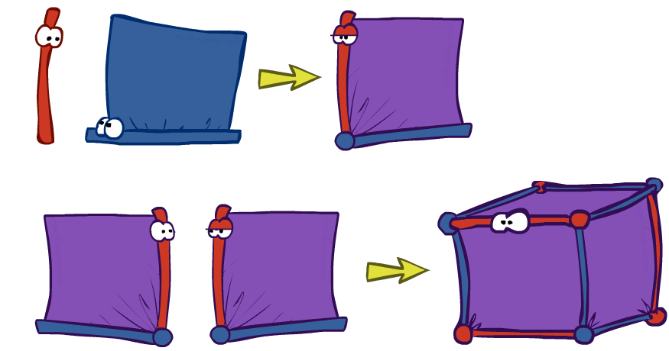
Example: Multiple Joins

Slide 22

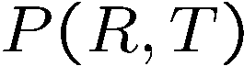
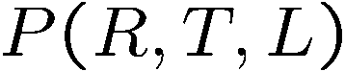
Example: Multiple Joins
+r | 0.1
-r | 0.9
R
Join R
Join T
+r | +t | 0.08
+r | -t | 0.02
-r | +t | 0.09
-r | -t | 0.81
R, T, L
T
+r | +t | 0.8
+r | -t | 0.2
-r | +t | 0.1
-r | -t | 0.9
R, T
+r | +t | +l | 0.024
+r | +t | -l | 0.056
+r | -t | +l | 0.002
+r | -t | -l | 0.018
-r | +t | +l | 0.027
-r | +t | -l | 0.063
-r | -t | +l | 0.081
-r | -t | -l | 0.729
L
L
+t | +l | 0.3
+t | -l | 0.7
-t | +l | 0.1
-t | -l | 0.9
+t | +l | 0.3
+t | -l | 0.7
-t | +l | 0.1
-t | -l | 0.9

Slide 23
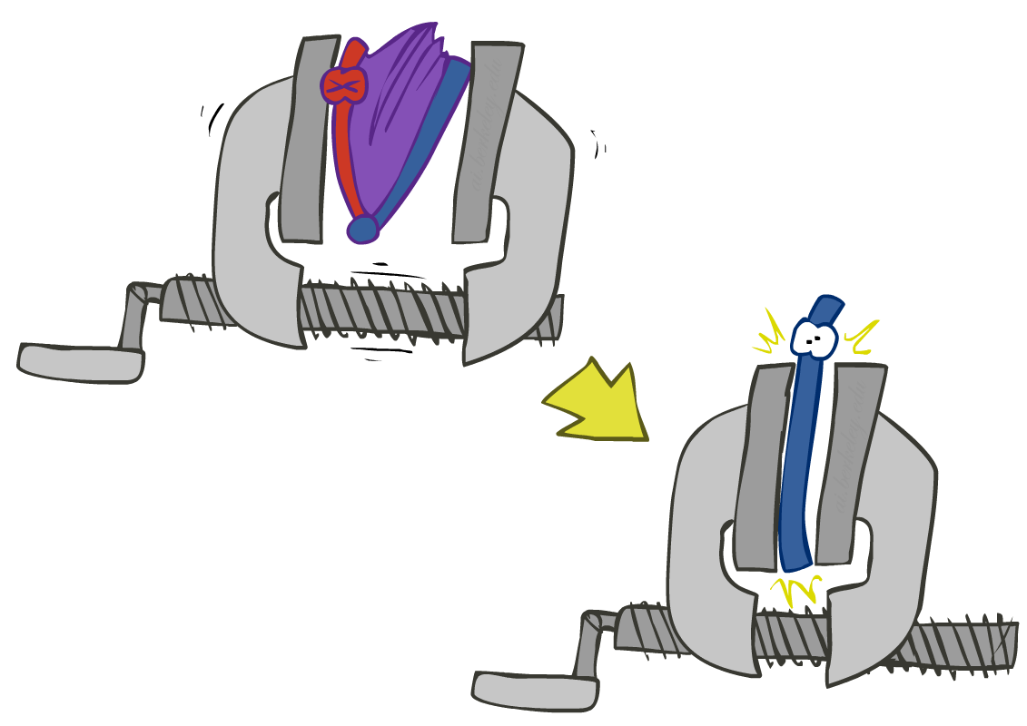

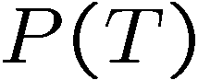
Operation 2: Eliminate
Second basic operation: marginalization
Take a factor and sum out a variable
Shrinks a factor to a smaller one
A projection operation
Example:
+r | +t | 0.08
+r | -t | 0.02
-r | +t | 0.09
-r | -t | 0.81
+t | 0.17
-t | 0.83

Slide 24



Multiple Elimination
R, T, L
T, L
L
+r | +t | +l | 0.024
+r | +t | -l | 0.056
+r | -t | +l | 0.002
+r | -t | -l | 0.018
-r | +t | +l | 0.027
-r | +t | -l | 0.063
-r | -t | +l | 0.081
-r | -t | -l | 0.729
Sum
out R
Sum
out T
+t | +l | 0.051
+t | -l | 0.119
-t | +l | 0.083
-t | -l | 0.747
+l | 0.134
-l | 0.886

Slide 25

Thus Far: Multiple Join, Multiple Eliminate (= Inference by Enumeration)

Slide 26

Marginalizing Early (= Variable Elimination)

Slide 27
Traffic Domain
R
Inference by Enumeration
Variable Elimination
T
L
Join on r
Join on r
Join on t
Eliminate r
Eliminate r
Join on t
Eliminate t
Eliminate t

Slide 28


Marginalizing Early! (aka VE)
Join R
Sum out R
Join T
Sum out T
+r | +t | 0.08
+r | -t | 0.02
-r | +t | 0.09
-r | -t | 0.81
+r | 0.1
-r | 0.9
+t | 0.17
-t | 0.83
R
T
T, L
R, T
L
+r | +t | 0.8
+r | -t | 0.2
-r | +t | 0.1
-r | -t | 0.9
T
L
L
+t | +l | 0.051
+t | -l | 0.119
-t | +l | 0.083
-t | -l | 0.747
+l | 0.134
-l | 0.866
L
+t | +l | 0.3
+t | -l | 0.7
-t | +l | 0.1
-t | -l | 0.9
+t | +l | 0.3
+t | -l | 0.7
-t | +l | 0.1
-t | -l | 0.9
+t | +l | 0.3
+t | -l | 0.7
-t | +l | 0.1
-t | -l | 0.9

Slide 29




Evidence
If evidence, start with factors that select that evidence
No evidence uses these initial factors:
Computing , the initial factors become:
We eliminate all vars other than query + evidence
+r | 0.1
-r | 0.9
+r | +t | 0.8
+r | -t | 0.2
-r | +t | 0.1
-r | -t | 0.9
+t | +l | 0.3
+t | -l | 0.7
-t | +l | 0.1
-t | -l | 0.9
+r | 0.1
+r | +t | 0.8
+r | -t | 0.2
+t | +l | 0.3
+t | -l | 0.7
-t | +l | 0.1
-t | -l | 0.9

Slide 30

Evidence II
Result will be a selected joint of query and evidence
E.g. for P(L | +r), we would end up with:
To get our answer, just normalize this!
That ’s it!
Normalize
+r | +l | 0.026
+r | -l | 0.074
+l | 0.26
-l | 0.74

Slide 31




General Variable Elimination
Query:
Start with initial factors:
Local CPTs (but instantiated by evidence)
While there are still hidden variables (not Q or evidence):
Pick a hidden variable H
Join all factors mentioning H
Eliminate (sum out) H
Join all remaining factors and normalize

Slide 32










Example
Choose A

Slide 33




Example
Choose E
Finish with B
Normalize

Slide 34





Example 2: P(B|a)
Start / Select
Join on B
Normalize
B
a, B
B | P
+b | 0.1
¬b | 0.9
a
A | B | P
+a | +b | 0.08
+a | ¬b | 0.09
A | B | P
+a | +b | 8/17
+a | ¬b | 9/17
B | A | P
+b | +a | 0.8
b | ¬a | 0.2
¬b | +a | 0.1
¬b | ¬a | 0.9

Slide 35

Same Example in Equations
marginal can be obtained from joint by summing out
use Bayes’ net joint distribution expression
use x*(y+z) = xy + xz
joining on a, and then summing out gives f₁
use x*(y+z) = xy + xz
joining on e, and then summing out gives f₂
All we are doing is exploiting uwy + uwz + uxy + uxz + vwy + vwz + vxy +vxz = (u+v)(w+x)(y+z) to improve computational efficiency!

Slide 36








Another Variable Elimination Example
Computational complexity critically depends on the largest factor being generated in this process. Size of factor = number of entries in table. In example above (assuming binary) all factors generated are of size 2 --- as they all only have one variable (Z, Z, and X₃ respectively).

Slide 37




Variable Elimination Ordering
For the query P(X_{n}|y₁,…,y_{n}) work through the following two different orderings as done in previous slide: Z, X₁, …, X_{n-1} and X₁, …, X_{n-1}, Z. What is the size of the maximum factor generated for each of the orderings?
Answer: 2^{n+1} versus 2² (assuming binary)
In general: the ordering can greatly affect efficiency.
…
…

Slide 38
VE: Computational and Space Complexity
The computational and space complexity of variable elimination is determined by the largest factor
The elimination ordering can greatly affect the size of the largest factor.
E.g., previous slide’s example 2^{n} vs. 2
Does there always exist an ordering that only results in small factors?
No!

Slide 39
















Worst Case Complexity?
CSP:
If we can answer P(z) equal to zero or not, we answered whether the 3-SAT problem has a solution.
Hence inference in Bayes’ nets is NP-hard. No known efficient probabilistic inference in general.
…
…

Slide 40
Polytrees
A polytree is a directed graph with no undirected cycles
For poly-trees you can always find an ordering that is efficient
Try it!!
Cut-set conditioning for Bayes’ net inference
Choose set of variables such that if removed only a polytree remains
Exercise: Think about how the specifics would work out!

Slide 41

Bayes’ Nets
Representation
Conditional Independences
Probabilistic Inference
Enumeration (exact, exponential complexity)
Variable elimination (exact, worst-case exponential complexity, often better)
Inference is NP-complete
Sampling (approximate)
Learning Bayes’ Nets from Data

Slide 42

Approximate Inference: Sampling

Slide 43

Sampling
Sampling is a lot like repeated simulation
Predicting the weather, basketball games, …
Basic idea
Draw N samples from a sampling distribution S
Compute an approximate posterior probability
Show this converges to the true probability P
Why sample?
Learning: get samples from a distribution you don’t know
Inference: getting a sample is faster than computing the right answer (e.g. with variable elimination)

Slide 44


Sampling
Sampling from given distribution
Step 1: Get sample u from uniform distribution over [0, 1)
E.g. random() in python
Step 2: Convert this sample u into an outcome for the given distribution by having each outcome associated with a sub-interval of [0,1) with sub-interval size equal to probability of the outcome
Example
If random() returns u = 0.83, then our sample is C = blue
E.g, after sampling 8 times:
C | P(C)
red | 0.6
green | 0.1
blue | 0.3

Slide 45
Sampling in Bayes’ Nets
Prior Sampling
Rejection Sampling
Likelihood Weighting
Gibbs Sampling

Slide 46

Prior Sampling

Slide 47




Prior Sampling
+c | 0.5
-c | 0.5
Cloudy
Cloudy
+c | +s | 0.1
 | -s | 0.9
-c | +s | 0.5
 | -s | 0.5
+c | +r | 0.8
 | -r | 0.2
-c | +r | 0.2
 | -r | 0.8
Sprinkler
Sprinkler
Rain
Rain
WetGrass
WetGrass
Samples:
+s | +r | +w | 0.99
 |  | -w | 0.01
 | -r | +w | 0.90
 |  | -w | 0.10
-s | +r | +w | 0.90
 |  | -w | 0.10
 | -r | +w | 0.01
 |  | -w | 0.99
+c, -s, +r, +w
-c, +s, -r, +w
…

Slide 48
Prior Sampling
For i=1, 2, …, n
Sample x_{i} from P(X_{i} | Parents(X_{i}))
Return (x₁, x₂, …, x_{n})

Slide 49



Prior Sampling
This process generates samples with probability:
…i.e. the BN’s joint probability
Let the number of samples of an event be
Then
I.e., the sampling procedure is consistent

Slide 50
Example
We’ll get a bunch of samples from the BN:
+c, -s, +r, +w
+c, +s, +r, +w
-c, +s, +r, -w
+c, -s, +r, +w
-c, -s, -r, +w
If we want to know P(W)
We have counts <+w:4, -w:1>
Normalize to get P(W) = <+w:0.8, -w:0.2>
This will get closer to the true distribution with more samples
Can estimate anything else, too
What about P(C| +w)? P(C| +r, +w)? P(C| -r, -w)?
Fast: can use fewer samples if less time (what’s the drawback?)
C
S
R
W

Slide 51

Rejection Sampling

Slide 52
Rejection Sampling
Let’s say we want P(C)
No point keeping all samples around
Just tally counts of C as we go
Let’s say we want P(C| +s)
Same thing: tally C outcomes, but ignore (reject) samples which don’t have S=+s
This is called rejection sampling
It is also consistent for conditional probabilities (i.e., correct in the limit)
C
S
R
W
+c, -s, +r, +w
+c, +s, +r, +w
-c, +s, +r, -w
+c, -s, +r, +w
-c, -s, -r, +w

Slide 53
Rejection Sampling
IN: evidence instantiation
For i=1, 2, …, n
Sample x_{i} from P(X_{i} | Parents(X_{i}))
If x_{i} not consistent with evidence
Reject: Return, and no sample is generated in this cycle
Return (x₁, x₂, …, x_{n})

Slide 54


Likelihood Weighting

Slide 55



Likelihood Weighting
Problem with rejection sampling:
If evidence is unlikely, rejects lots of samples
Evidence not exploited as you sample
Consider P(Shape|blue)
Idea: fix evidence variables and sample the rest
Problem: sample distribution not consistent!
Solution: weight by probability of evidence given parents
pyramid, green
pyramid, red
sphere, blue
cube, red
sphere, green
pyramid, blue
pyramid, blue
sphere, blue
cube, blue
sphere, blue
Shape
Color
Shape
Color

Slide 56



Likelihood Weighting
+c | 0.5
-c | 0.5
Cloudy
Cloudy
+c | +s | 0.1
 | -s | 0.9
-c | +s | 0.5
 | -s | 0.5
+c | +r | 0.8
 | -r | 0.2
-c | +r | 0.2
 | -r | 0.8
Sprinkler
Sprinkler
Rain
Rain
WetGrass
Samples:
WetGrass
+s | +r | +w | 0.99
 |  | -w | 0.01
 | -r | +w | 0.90
 |  | -w | 0.10
-s | +r | +w | 0.90
 |  | -w | 0.10
 | -r | +w | 0.01
 |  | -w | 0.99
+c, +s, +r, +w
…

Slide 57

Likelihood Weighting
IN: evidence instantiation
w = 1.0
for i=1, 2, …, n
if X_{i} is an evidence variable
X_{i} = observation x_{i} for X_{i}
Set w = w * P(x_{i} | Parents(X_{i}))
else
Sample x_{i} from P(X_{i} | Parents(X_{i}))
return (x₁, x₂, …, x_{n}), w

Slide 58




Likelihood Weighting
Sampling distribution if z sampled and e fixed evidence
Now, samples have weights
Together, weighted sampling distribution is consistent
Cloudy
C
S
R
W

Slide 59

Likelihood Weighting
Likelihood weighting is good
We have taken evidence into account as we generate the sample
E.g. here, W’s value will get picked based on the evidence values of S, R
More of our samples will reflect the state of the world suggested by the evidence
Likelihood weighting doesn’t solve all our problems
Evidence influences the choice of downstream variables, but not upstream ones (C isn’t more likely to get a value matching the evidence)
We would like to consider evidence when we sample every variable
→ Gibbs sampling

Slide 60

Gibbs Sampling

Slide 61
Gibbs Sampling
Procedure: keep track of a full instantiation x₁, x₂, …, x_{n}. Start with an arbitrary instantiation consistent with the evidence. Sample one variable at a time, conditioned on all the rest, but keep evidence fixed. Keep repeating this for a long time.
Property: in the limit of repeating this infinitely many times the resulting sample is coming from the correct distribution
Rationale: both upstream and downstream variables condition on evidence.
In contrast: likelihood weighting only conditions on upstream evidence, and hence weights obtained in likelihood weighting can sometimes be very small. Sum of weights over all samples is indicative of how many “effective” samples were obtained, so want high weight.

Slide 62
Gibbs Sampling Example: P( S | +r)
Step 1: Fix evidence
R = +r
Steps 3: Repeat
Choose a non-evidence variable X
Resample X from P( X | all other variables)
Step 2: Initialize other variables
Randomly
C
C
S
+r
S
+r
W
W
C
C
C
C
C
C
S
+r
S
+r
S
+r
S
+r
S
+r
S
+r
W
W
W
W
W
W

Slide 63
Gibbs Sampling
How is this better than sampling from the full joint?
In a Bayes’ Net, sampling a variable given all the other variables (e.g. P(R|S,C,W)) is usually much easier than sampling from the full joint distribution
Only requires a join on the variable to be sampled (in this case, a join on R)
The resulting factor only depends on the variable’s parents, its children, and its children’s parents (this is often referred to as its Markov blanket)

Slide 64

Efficient Resampling of One Variable
C
Sample from P(S | +c, +r, -w)
Many things cancel out – only CPTs with S remain!
More generally: only CPTs that have resampled variable need to be considered, and joined together
S
+r
W

Slide 65





Bayes’ Net Sampling Summary
Prior Sampling P
Likelihood Weighting P( Q | e)
Rejection Sampling P( Q | e )
Gibbs Sampling P( Q | e )

